Slide 1
Old CDS Data flow
IRA Enrollment
IRA FA
Manual entry
Excel fill
Manual copy
Fillable PDF
Remediate
Website
IRA Course Grade etc.
IRA Degree Recipients

Slide 2
CDS Data flow
Custom Qlik apps/sheets
Download
Excel fill
Python
Fillable PDF
QAP
IRA Website

Slide 3
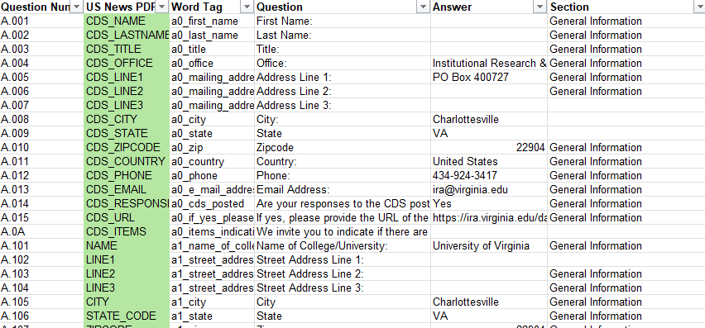
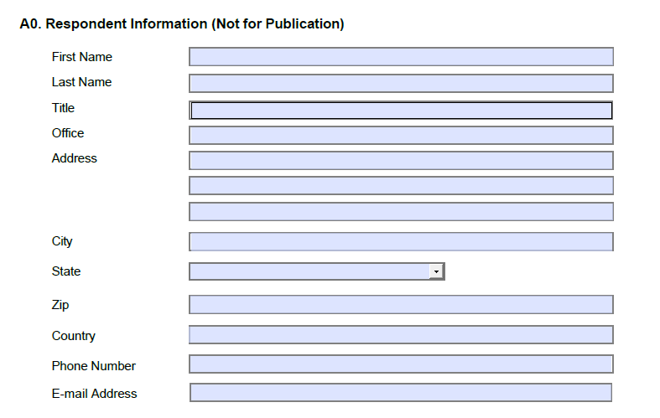
What the python script does

Slide 4
Python Script
Load Excel file
Load PDF file
For each field in the pdf:
Look up the excel file value with the same field name
Write the excel value to the pdf
Save PDF

